Slide 1
MES Agile Oversight Model
Notes:
This is not Agile delivery methodology training but agile oversight training

Slide 2
Why Are We Here?

Slide 3
Purpose of Today’s Session
Why are we here?
Introduce the MES Agile Oversight Model pilot
Explain what is changing — and what is not

Slide 4
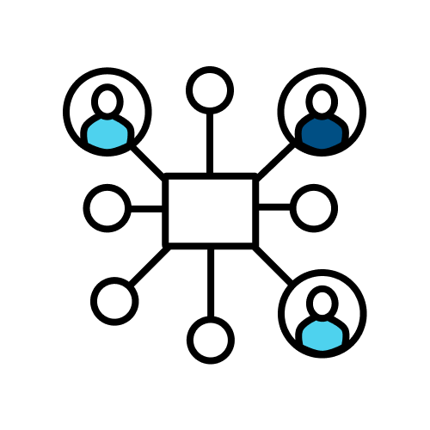
Why CMS Is Evolving Oversight
Why are we here?
States are delivering increasingly complex Medicaid Enterprise Systems using agile methods.
Traditional oversight has often been:
Document-heavy
Retrospective
Milestone-driven rather than value-driven
We are updating our oversight approach to better align with states’ best practices for building MES systems.

Slide 5
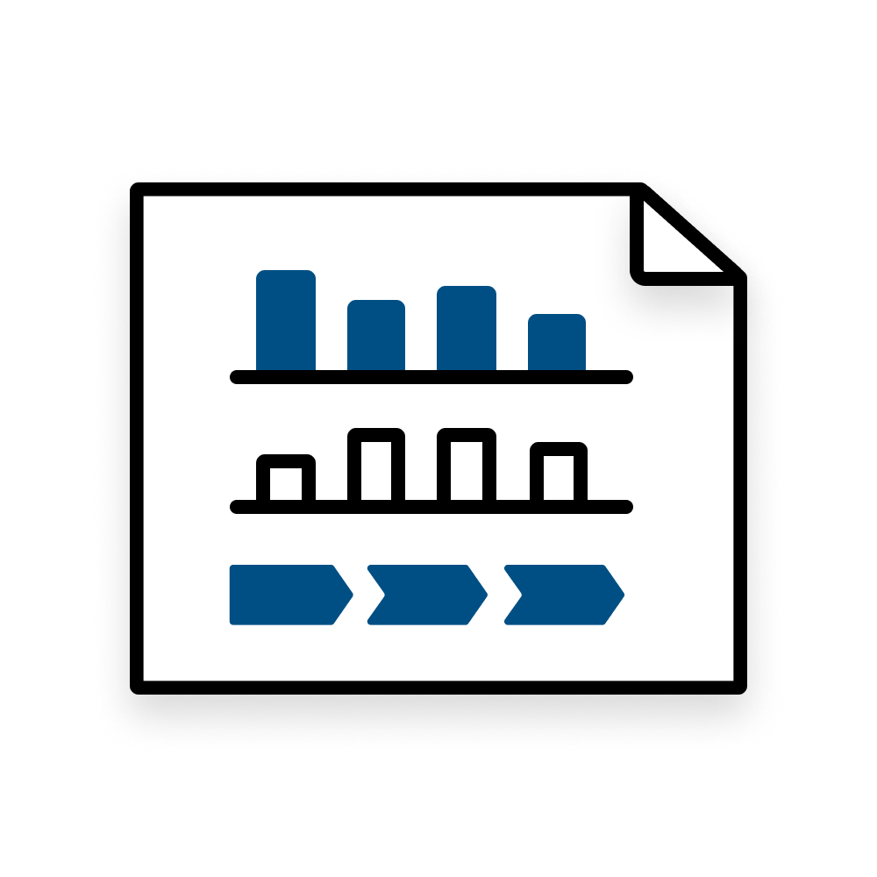
What Is the Agile Oversight Model?
Why are we here?
A cadence-based, portfolio-level oversight approach that emphasizes:
Regular biweekly portfolio sync meetings
Demonstrations of working functionality
Early identification and timely resolution of issues and blockers
Early and consistent identification and mitigation of risks
Evidence-based status reporting
This is about clarity and alignment — not added reporting.
Notes:
Added Talking Point to this section based on Nora Comment
We currently hold monthly meetings at varying times and cadences based on what has evolved as the norm over time with your states. This moved to a standard bi-weekly cadence for all states.

Slide 6
What Is Changing (and What Is Not)
Why are we here?
What Is Changing
Biweekly portfolio sync cadence (replacing monthly meetings)
Demos for DDI projects integrated into oversight
More emphasis on demonstrated value
Evidence-based status reports
Earlier escalation of issues and risks
What Is Not Changing
FFP match rates and rules
APD approval requirements
Federal funding rules
State project management practices
Existing delivery governance
The model changes how states engage with CMS—not how they manage their projects internally.
Notes:
We are shifting toward observation over documentation, using demonstrated progress and working functionality as primary inputs. CMS will look to leverage existing flexibilities (e.g., APD waivers) to reduce unnecessary documentation where appropriate From Nora: Another talking point is want to emphasize these should be regular vendor demos with states that CMS attends. These shouldn't be rehearsed and choreographed events like you would see for a certification review. And that we understand it will take some time to build trust but CMS attendance is in partnership with state to understand how projects are progressing - the expectation is not that vendor and state put on a show for CMS.

Slide 7

What’s In It For States
Why are we here?
This model is designed to:
Reduce ad hoc reporting requests
Promote earlier issue and risk visibility and decrease last-minute escalations
Allow CMS to provide TA earlier and more effectively
Align APD conversations with delivery reality
Provide clearer expectations from CMS
Create more predictable engagement
Goal: Fewer surprises. More transparency.
Notes:
Earlier risk visibility = decreased last minute escalations → This will allow CMS to provide TA earlier and help states resolve issues earlier when its easier and less costly to solve them.

Slide 8
What the Pilot Entails

Slide 9


Pilot Goals
What the Pilot Entails
This pilot is limited in scope, learning-focused, and iterative. It will test:
Biweekly portfolio sync meetings
DDI demos
Evidence-based status reports
Defined escalation thresholds
Pilot Timeline
May–June: Kickoff, Initial sync cycles
June–July: Refinement & calibration
August: Lessons learned & rollout decision

Slide 10
Biweekly Portfolio Syncs
What the Pilot Entails
Every meeting includes:​
Portfolio status round robin​
APDs and contract alignment ​
15-minute live DDI demo​
Discussion will focus on:
What changed
What was delivered
What issues or blockers have emerged — and how are they being addressed?
What risks are emerging and how are they being mitigated?
What’s next?
This is portfolio-level — not sprint-level

Slide 11
The goal is simple:
Closing
Align oversight with delivery reality.
Reduce surprises
Improve transparency
Strengthen partnerships
We look forward to learning together.

Slide 12
CMS’ Agile Oversight Model
Rhode Island’s Experience
Notes:
Notes:
-

Slide 13


RI Team Makeup
In Final Review
Deadline Next Week
Contract Managers
Financial Staff
Project Managers
Program Managers
CONTRACTS & APD WORK
Notes:
Notes:
Nicole to describe how documents requiring CMS review are handled in the RI Medicaid program and sister-agencies presently.

Slide 14

Rhode Island’s Preparations
Change / Expectation Management Conversations:
APD and Contract Owners
Executive Leadership
Vendors
Forecasting Demo Schedule
Updating Reporting Templates
In Final Review
Deadline Next Week
Deadline 2-3 Weeks
Notes:
* Reporting templates to help RI stay compliant with timeliness incl. Contracts, Procurement Planning, APD staggering.

Slide 15
Transition and Adjustments
Internal prep meeting scheduled monthly
Align team on modified reporting
Still working through some bumps here…
Involvement of our Financial Management Staff
Notes:
Notes:
Internal prep for info sharing, tips, tricks and alignment.

Slide 16
Benefits Recognized to Date
Clearer understanding of pipeline
Improved timeliness
Improved agency coordination
Smoother contract review/approval workflow
Procurement strategy information sharing
Inching towards improved coordination with RI Purchases
Improved documentation
Notes:
Notes:

Slide 17
Advice
Internal policies and procedures (financial and non-financial)
Internal APD workflow desk-reference guide
Sharepoint – version control
Notes:
Notes:

Slide 18
Questions?

Slide 19
Thank you!
Notes:
When can we meet with the state officers to begin follow up trainings?

